Slide 1
AUTOMATED SEGMENTATION AND IDENTIFICATION OF WILDLIFE FOR PREVENTING ROADKILLS IN HIGHWAYS
Batch number: B17
MENTOR:
Ms.Shobana.B.T(Assistant Professor,
Information Technology)
TEAM MEMBERS:
Padma Shneha –212715205061
Sahana Nagarajan – 21271520509674
Tandra Supraja - 212715205096

Slide 2
ABSTRACT
Roadkill refers to animals struck and killed by motor vehicles on highways.
It is a dangerous issue as there is a huge loss of animals , road safety, and the economic impact on both drivers and road management.
The study completely focuses on saving the wild animals from the high speed vehicles in highways.
The model proposed employs the technique of image processing to detect all kind of animals .
The device is attached to the road and when a detection of an animal crossing the road is made, a warning signal is given out that helps the driver to take the necessary steps to slow down their vehicle in advance thus saving the wildlife.

Slide 3
BASIC CONCEPTS
Road Kills
An act that takes a toll on the lives of humans or animals that happen to collide with the moving vehicle on the road.
An alarming problem that all the developed nations are facing today is death and injuries due to road accidents.
The human-animal conflict is one such big issue, which is predominant in the highway regions near the forest region.
Image processing
Image processing is a method to perform some operations on an image, in order to get an enhanced image or to extract some useful information from it.
Nowadays, image processing is among rapidly growing technologies. It forms core research area within engineering and computer science disciplines too.

Slide 4
BASIC CONCEPTS (contd.)
Machine Learning
Machine learning is a branch of science that deals with programming the systems in such a way that they automatically learn and improve with experience.
Learning means recognizing and understanding the input data and making wise decisions based on the supplied data.
These algorithms build knowledge from specific data and past experience with the principles of statistics, probability theory, logic, search, reinforcement learning, and control theory.

Slide 5
LITERATURE SURVEY
Matthias zeppelzauer 2013, 2013:46-”automated detection of elephants in wildlife video” in EURASIP journal on image and video processing
Dynamically learns color model of elephants from a few training images and localize elephants in video sequences with different backgrounds and lighting conditions.
Advantage:
1.Able to detect and track elephants of different sizes and poses
2.Provides the spatial location and complete tracking information for each detection.
Disadvantage:
1.Difficult to detect far-distant elephants and sensitivity to false detection.
2.Indexing of unconstrained wildlife video is difficult.

Slide 6
LITERATURE SURVEY (contd.)
Automated identification of animal species in camera trap images
- Xiaoyuan Yu1,2, Jiangping Wang2*, Roland Kays3,4,5, Patrick A Jansen3,6, Tianjiang Wang1 and Thomas Huang
Image sensors are increasingly being used in biodiversity monitoring, with each study generating many thousands or millions of pictures. Efficiently identifying the species captured by each image is a critical challenge for the advancement of this field.
Advantage:
The combination of SIFT and cLBP as descriptors of local images features significantly improved the recognition performance.
Disadvantage:
Biometric features species analysis need to be included in the local features, such as color, spots, and size of the body.

Slide 7
LITERATURE SURVEY (contd.)
Visual Informatics Tools for Supporting Large-Scale Collaborative Wildlife Monitoring with Citizen Scientists - zhihai He, roland Kays, zhi zhang, guanghan ning, chen Huang, tony X. Han, Josh millspaugh, tavis forrester, and William mcshea
Collaborative wildlife monitoring and tracking at large scales will help us understand the complex dynamics of wildlife systems, evaluate the impact of human actions and environmental changes on wildlife species, and answer many important ecological and evolutionary research questions.
Disadvantage:
Need to develop integrated camera-sensor networking systems, deploy them at large scales, and develop advanced computational and informatics tools to analyze and manage the massive wildlife monitoring data.

Slide 8
LITERATURE SURVEY (contd.)
From Tiger to Panda: Animal Head Detection
Weiwei Zhang, Jian Sun, and Xiaoou Tang, Fellow, IEEE
Robust object detection has many important applications in real-world online photo processing. For example, both Google image search and MSN live image search have integrated human face detector to retrieve face or portrait photos.
Advantage:
1.achieved much improved results by decomposing texture and shape features
2.improve the detection results through joint detection based on the shape and texture features
3.the texture and shape detectors are improved by a set of new oriented gradient features.
Disadvantage:
1.Less animals are used for detection.
2.Accuracy of the detection performance is less.

Slide 9
LITERATURE SURVEY (contd.)
Animal–Vehicle Collision Mitigation System for Automated Vehicles - Abdelhamid Mammeri, Depu Zhou, and Azzedine Boukerche
Detecting large animals on roadways using automated systems such as robots or vehicles is a vital task. This can be achieved using conventional tools such as ultrasonic sensors, or with innovative technology based on smart cameras.
Advantage:
Two-stage architecture LBP-AdaBoost/ HOG-SVM has shown a good performance in daytime conditions.
Disadvantage:
During the nighttime, the combination of LBP-AdaBoost and HOG-SVM has shown limited capabilities.

Slide 10
ISSUES AND CHALLENGES
There can be few instances where either the entry of the animal can be impromptu or the driver might face challenges in controlling the vehicle. In these cases collision is unavoidable.
Since the devices are set-up in an outdoor environment there are possibilities to either wear-out or can be damaged due to some external force.
100% Efficiency cannot be attained.
The efficiency of detecting the animal might be minimal during night time.

Slide 11
PROBLEM STATEMENT
Roadkill is an act that takes a toll on the lives of humans or animals that happen to collide with the moving vehicle on the road.
It is a global tragedy with an ever-rising trend.
This study completely focuses on saving the wild animals from the high speed vehicles in highways.
The model proposed employs the technique of image processing to detect all kind of animals.
It is attached to the road and when a detection of an animal crossing the road is made, a warning signal is notified to the drivers.

Slide 12
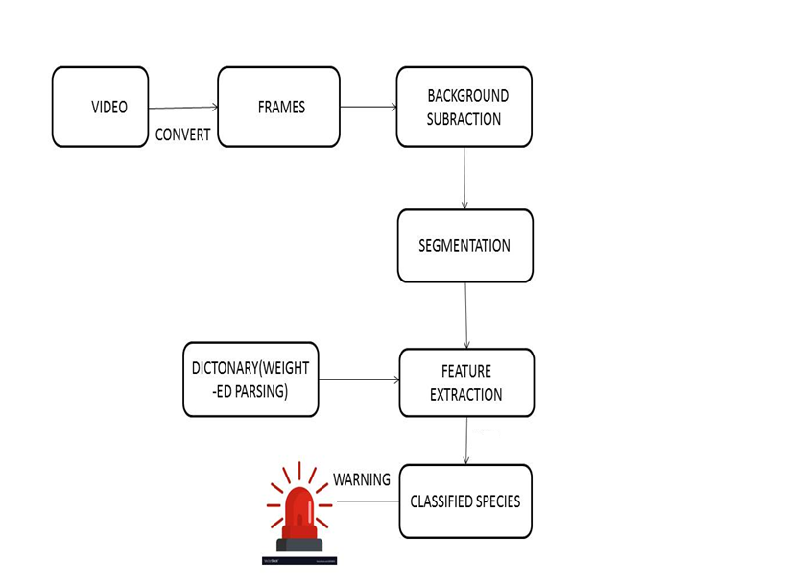
PROPOSED ARCHITECTURE

Slide 13
MODULE
Conversion of video to frame
Conversion of RGB to gray scale
Background subtraction
Display the extracted area of coverage
Identification of objects in the area of coverage
Recognition of animals
Warning signal

Slide 14
MODULE DESCRIPTION
Conversion of video to frame
A video is captured to monitor the activities on the highways and it is converted into individual frames.
Conversion of RGB to gray scale
The converted frame is converted from colored image to gray scaled image to perform further processing

Slide 15
MODULE DESCRIPTION
Background subtraction
The unwanted region is eliminated from the frames captured. Hough transform algorithm is used for the same.
Display the extracted area of coverage
The extracted area is displayed by the reference lines in the output.
Harr Cascade Classifer
Object Detection using Haar feature-based cascade classifiers is an effective object detection method. It is a machine learning based approach where a cascade function is trained from a lot of positive and negative images. It is then used to detect objects in other images.

Slide 16
MODULE DESCRIPTION
Identification of objects in the area of coverage
All the objects are recognized, the outer region is eliminated and the inner part is on continuous observation.
Recognition of animals
Now, any object that is intruded in the inner region will be detected and compared to the benchmarked images.
Indication
Whenever an animal is identified, an indication is notified.

Slide 17
SYSTEM REQUIREMENT AND TOOLS
SOFTWARE REQUIREMNTS
Tool - Anaconda 3.
Language – Python.
Library functions :-
- openCV :
It is a cross-platform library using which we can develop real-time computer vision applications.
- numpy :
It provides a high-performance multidimensional array and basic tools to compute with and manipulate these arrays.

Slide 18
SYSTEM REQUIREMENT AND TOOLS (contd.)
HARDWARE REQUIREMENTS
- CAMERA
It is an optical instrument used for electronic motion picture acquisition, which are stored in a physical medium such as in a digital system or on photographic film.
- HARD DISK
It is used to store the large number of trained datasets of various animals.

Slide 19
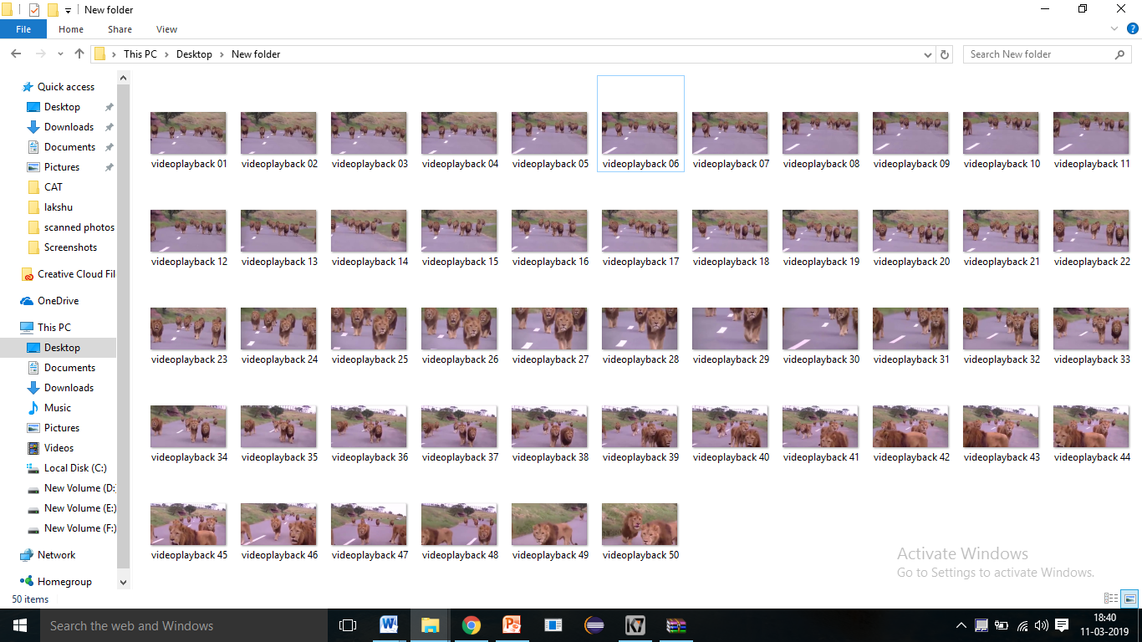
SCREENSHOTS
Fig 1: video to frame

Slide 20
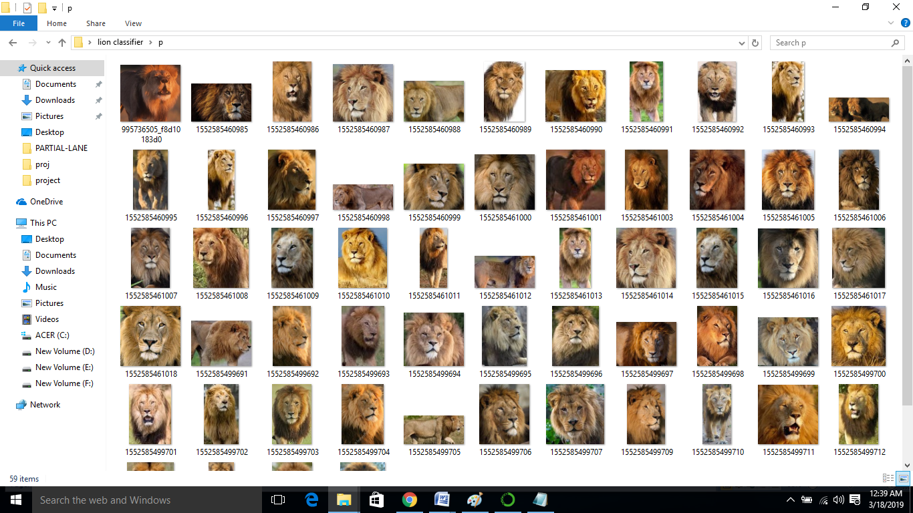
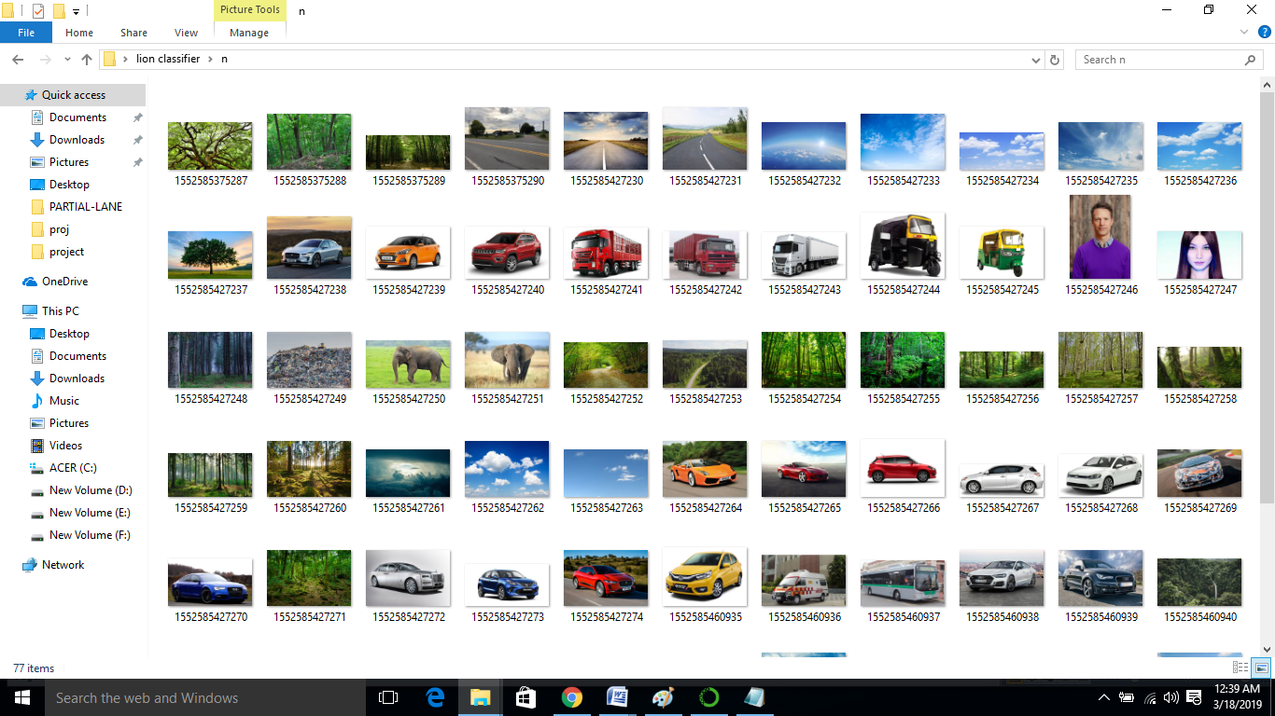
SCREENSHOTS
Fig 2: Positive Images
Fig 3: Negative Images

Slide 21
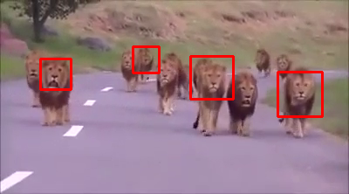
SCREENSHOTS
Fig 4: Detection of animals

Slide 22
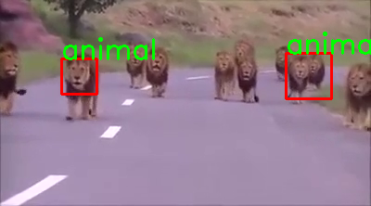
SCREENSHOTS
Fig 5: Recognition of animals

Slide 23
CONCLUSION
The proposed system effectively helps in preventing roadkills in the highway regions. This reduces the fatality of drivers, vehicles and animals.
Though the proposed work has been focused on automatic animal detection in context to Indian highways, it will work in other countries also.
It can be offered as a complete solution (package) for preventing collisions and loss of human life on highways.

Slide 24
FUTURE SCOPE
It cannot give warning signals before-hand if the vehicle is only at a distance of 5 metres or less from the animal .
High-end resolution cameras can be used to detect animals during the night

Slide 25
REFERENCES
[1] J Billingsley, M Dunn, N Finch, in Proceedings of the 10th Annual Conference on Mechatronics andMachine Vision in Practice,Mechatronics and Machine Vision 2003: Future Trends Machine vision classification of animals. Research Studies Press Ltd, Baldock, 2013, ed. by J Billingsley (Perth, Australia, 9–11 December 2013)
[2] D Edgington, C Koch, D Walther, in Proceedings of the 2004 IEEE Computer Society Conference on Computer Vision and Pattern Recognition (CVPR),Washington, DC, vol. 1. Detection and tracking of objects in underwater video (IEEE, New York, 2014, 27 June–2 July), pp. 544–549V
[3] T Berg, D Forsyth, in IEEE Computer Society Conference on Computer Vision and Pattern Recognition (CVPR), Animals on the web, New York, vol. 2 (IEEE, New York, 2016, 17–22 June), pp. 1463–1470

Slide 26
REFERENCES (contd.)
[4] H Afkham, J Eklundh, A Pronobis, A Targhi, in Proceedings of the 19th International Conference on Pattern Recognition (ICPR) Joint visual
vocabulary for animal classification, Tampa (IEEE, New York, 2018, 8–11 December 2018), pp. 1–4
[5] C Carbone, J Eggert, T Fountain, Z He, P Jansen, R Kays, B Kranstauber, M Rowcliffe, S Tilak, Monitoring wild animal communities with arrays of motion sensitive camera traps. Int J Res Rev Wireless Sensor Netw. 1, 19–29 (2011)
[6] J Ahumada, C Baru, S Chandra, E Fegraus, K Lin, C Youn, Data acquisition and management software for camera trap data: a case study from the TEAM Network. Ecol. Inform. 6(6), 345–353 (2016)

Slide 27
ANNEXURE
Capturing the video
cap = cv2.VideoCapture(r'C:\Users\latha\Desktop\y2mate.com lions_walk_in_the_road_kings_are_walking_24UKtRLtpJM_360p (online-video-cutter.com) (1).mp4')

Slide 28
ANNEXURE
Reads frames from a video
ret, frames = cap.read()

Slide 29
ANNEXURE
Conversion RGB to gray scale
gray = cv2.cvtColor(frames, cv2.COLOR_BGR2GRAY)

Slide 30
ANNEXURE
Detection of objects
elephant = elephant_cascade.detectMultiScale(gray, 1.1, 1)

Slide 31
ANNEXURE
To draw a rectangle in each animal:
cv2.rectangle(frames,(x,y),(x+w,y+h),(0,0,255),2)
cv2.putText(frames, "animal", (x, y), font,1, (0,255,0), 2)

Slide 32
ANNEXURE
Display final output video
cv2.imshow('video2', frames)
if cv2.waitKey(33) == 27:
break

Slide 33
ANNEXURE
Haar Cascade Classifier:
elephant_cascade = cv2.CascadeClassifier(r'C:\Users\latha\Desktop\lion classifier\classifier\cascade.xml')
font = cv2.FONT_HERSHEY_SIMPLEX

Slide 34
THANK YOU

